Slide 1
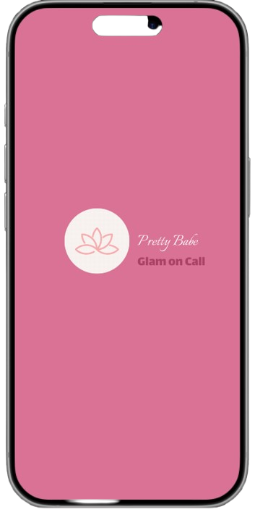
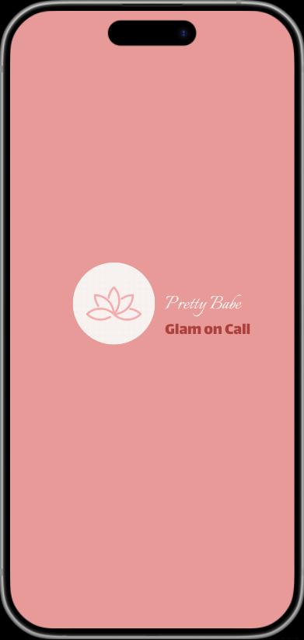
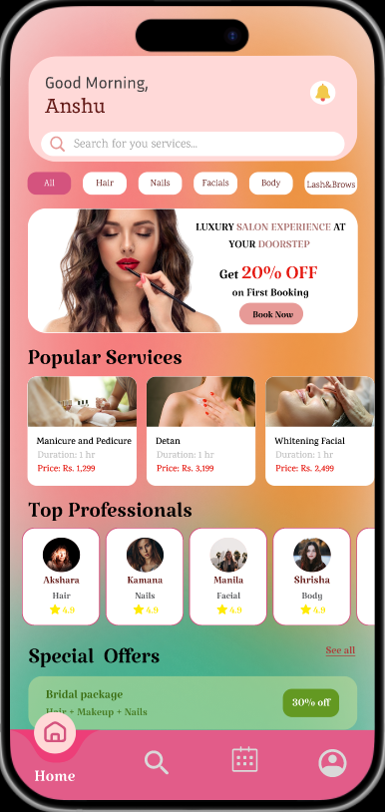
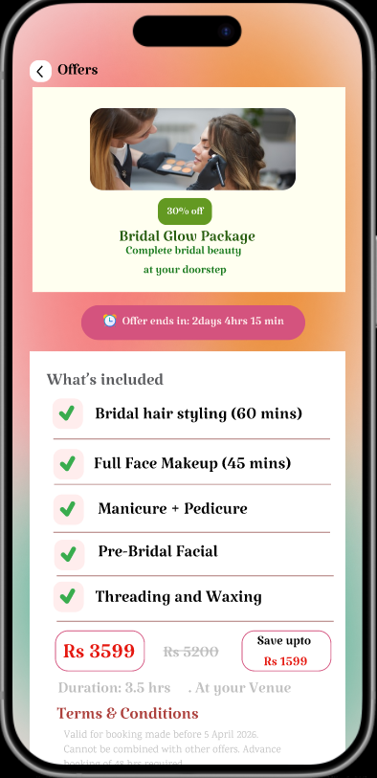
DOOR-STEP BEAUTY
SERVICE APP
UI UX CASE STUDY
Using Figma
PROJECT BY:
ANSHU HADA
Section : A

Slide 2

PROBLEM STATEMENT
No Easy Booking
Trust & Safety Issues
Users struggle to find and book nearby beauty professionals quickly and reliably.
Concerns about letting strangers into homes without verified professional credentials.
Inconsistent Quality
Payment Complexity
Service quality varies widely; no standardized ratings or review system in place.
Complicated payment flows, no upfront pricing, and lack of secure in-app payment options.

Slide 3




PROPOSED SOLUTION
Smart Service Discovery
Verified Professional Badges
Location-based search to find verified beauty professionals nearby with real-time availability.
Background-checked pros with ratings, reviews, portfolio photos, and certifications.
Instant Slot Booking
Secure In-App Payments
One-tap scheduling with live calendar sync, reminders, and easy rescheduling.
Multiple payment options with transparent pricing, no hidden fees, and digital receipts.

Slide 4
UX DESIGN THINKING PROCESS
01
02
03
04
Empathize
Define
Ideate
Design
Understand users, their needs, and their pain points through interviews and surveys.
Clearly frame the core problem based on user insights and research findings.
Generate as many creative solutions as possible — diverge before converging.
Transform ideas into structured, user-friendly interfaces and prototypes.

Slide 5

USER PERSONA (DEFINE)
P
Problems
Solutions
No time to visit salon after long work hours.
Quick booking with verified pro profiles.
Difficult to trust unknown professionals at home.
Ratings, reviews & background checks visible.
Priya Sharma
Age: 29
Marketing Manager
Kathmandu
Unclear service pricing causes booking hesitation.
Upfront pricing with no hidden charges.
L
Problems
Solutions
Limited budget; no transparency on salon prices.
Affordable packages & student discounts.
App crashes or glitches during payment flow.
Stable, tested payment flow with fallback options.
Latika Shrestha
Age: 23
College Student
Lalitpur
Difficulty finding specific services near campus.
Location-based filtering for nearby service providers.

Slide 6
USER INTERVIEW (QUALITATIVE RESEARCH)
1
How often do you visit a salon or use beauty services?
I go to the salon every 3-4 weeks, but it takes too much time commuting. I wish someone could come home.
2
What difficulties have you faced with beauty service apps?
The app I tried crashed during payment. I had to start over and ended up losing my booking.
3
What would make a doorstep beauty service more convenient?
Simple booking, knowing who is coming, and clear pricing before I confirm. No surprises.
4
Do you prefer basic or feature-rich apps?
A balance — easy for regular bookings, but with options if I want to explore or customize services.

Slide 7
SURVEY (QUANTITATIVE RESEARCH)
How often do you use beauty services?
Which apps do you currently use?
Have you faced issues with bookings?
Most important factor for you?

Slide 8
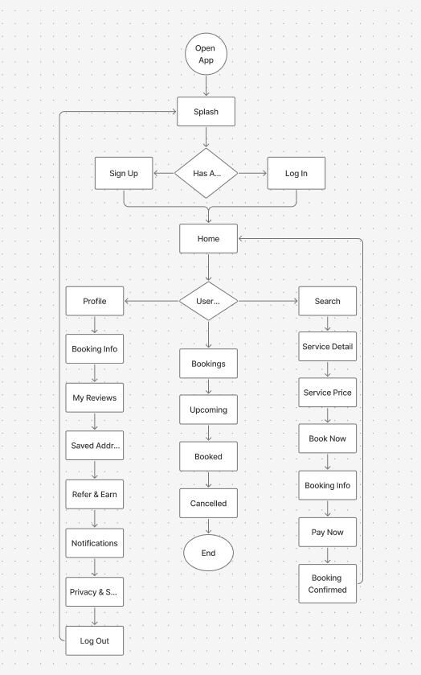
USER FLOW (IDEATE)

Slide 9
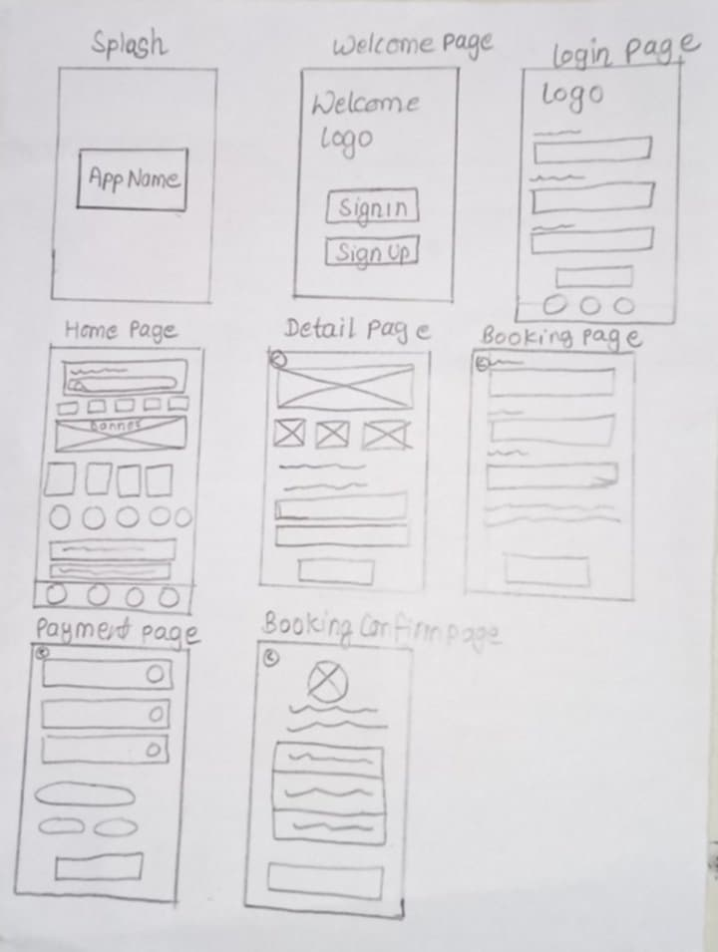
LOW FIDELITY (IDEATE)

Slide 10
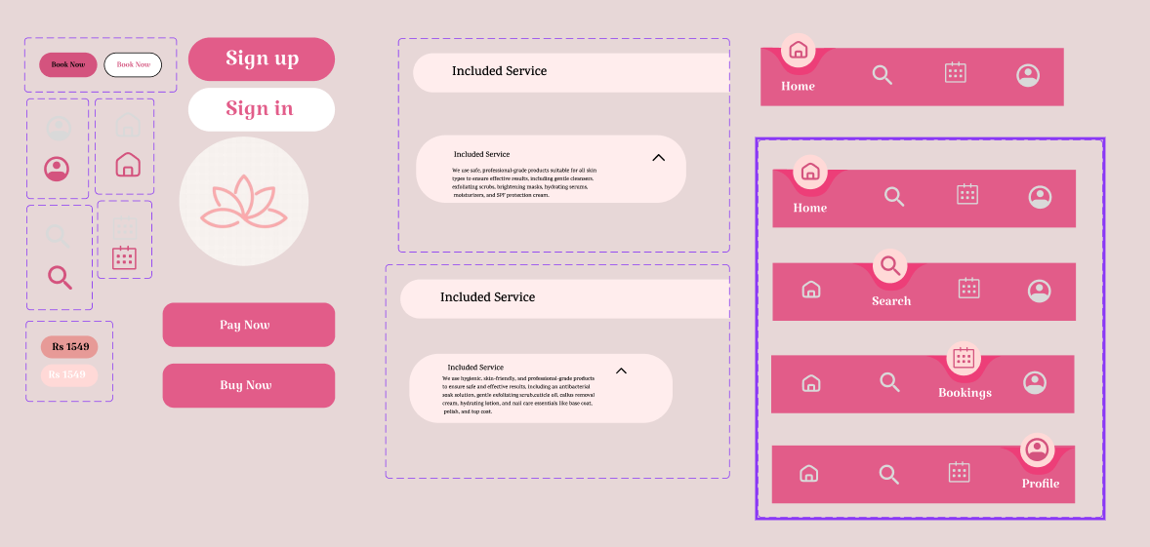
DESIGN SYSTEM

Slide 11
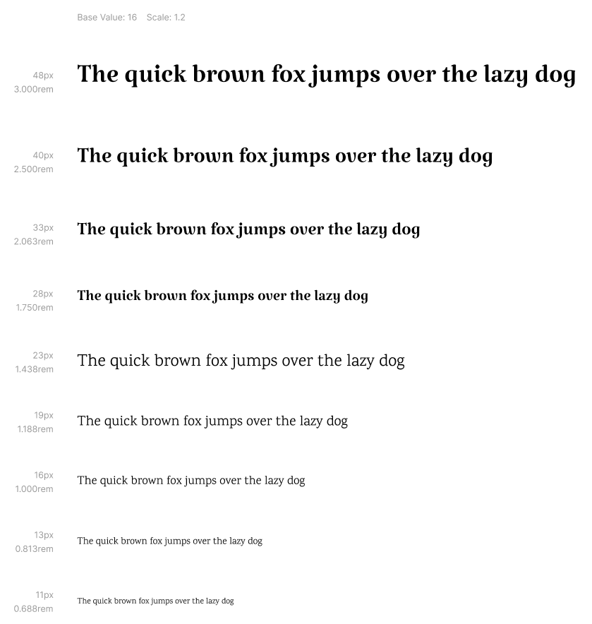
DESIGN SYSTEM
TYPOGRAPHY

Slide 12
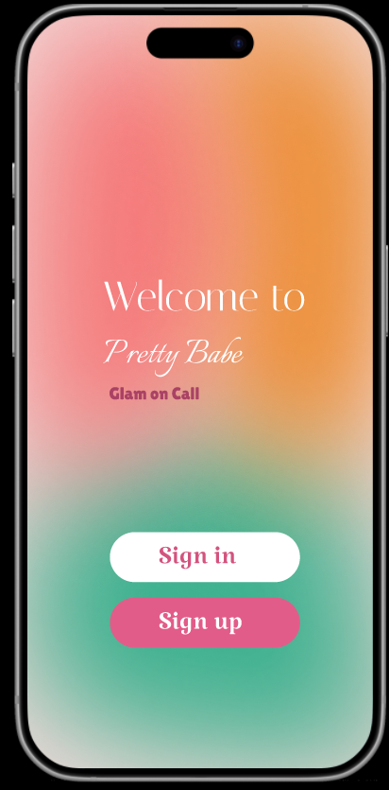
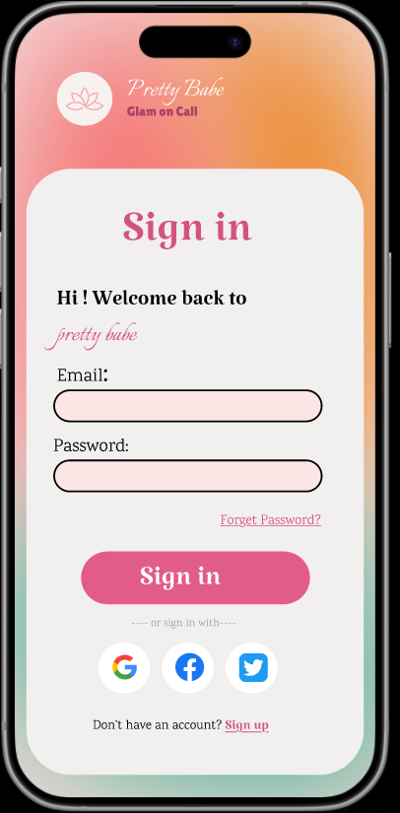
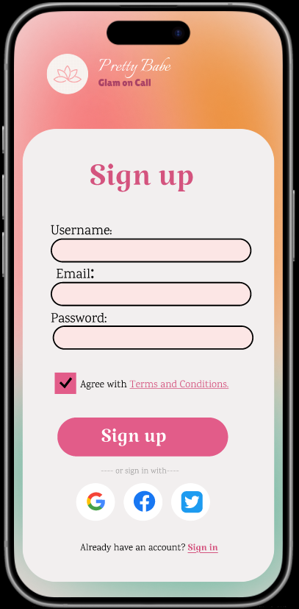
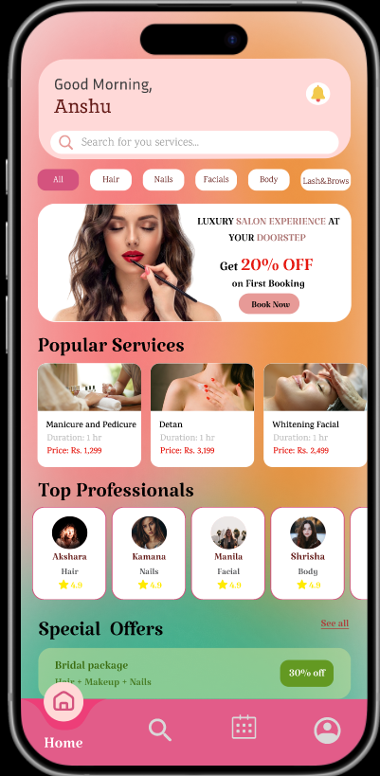
USER INTERFACE

Slide 13
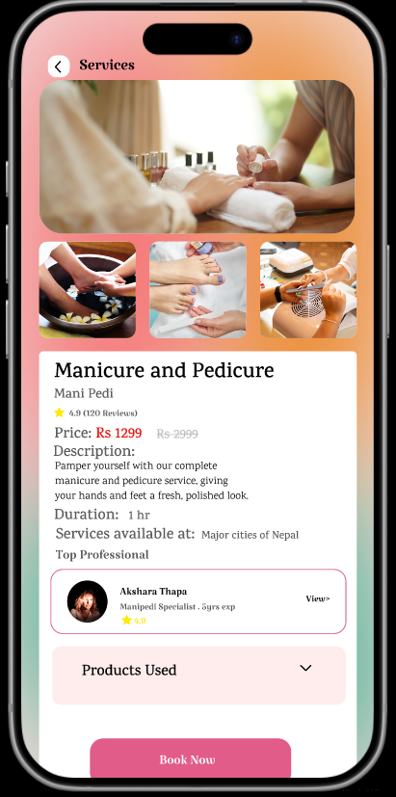
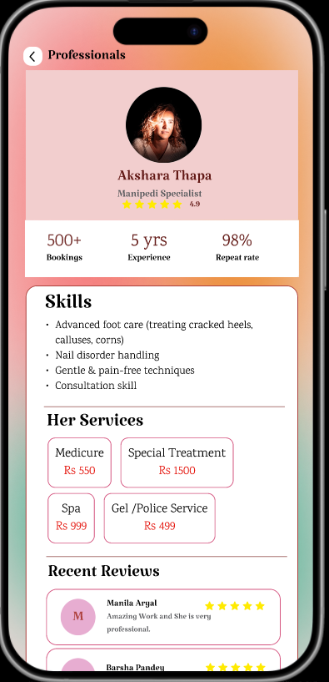
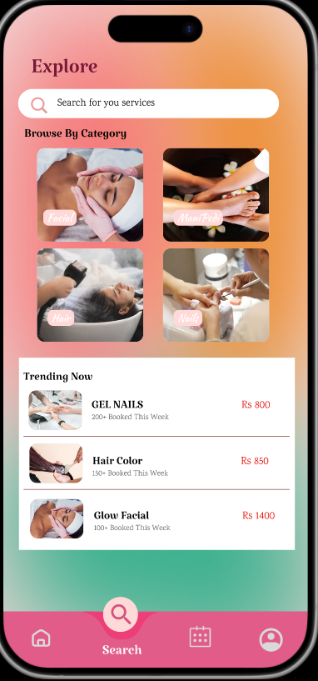
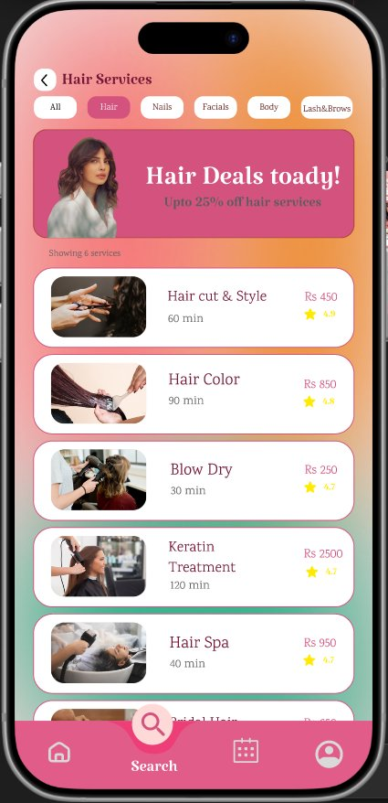
USER INTERFACE

Slide 14
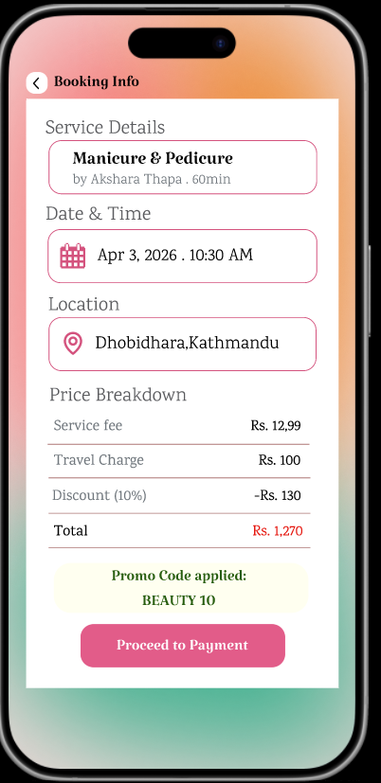
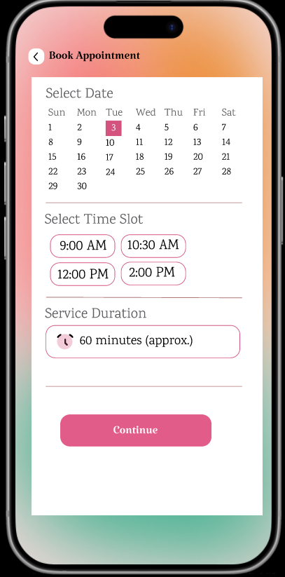
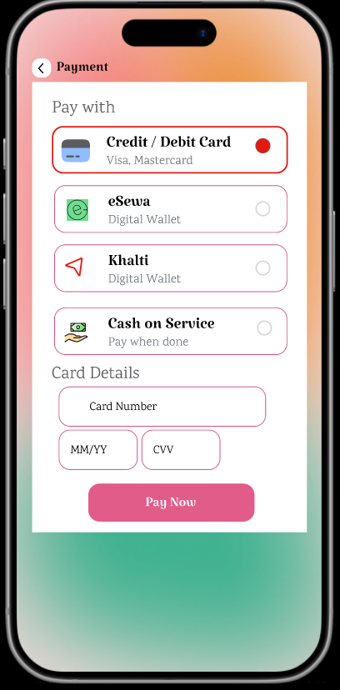
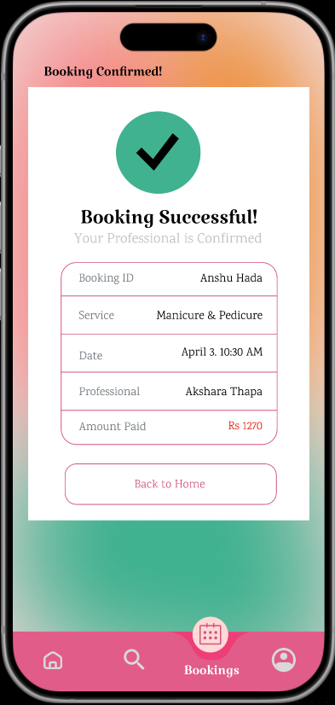
USER INTERFACE

Slide 15
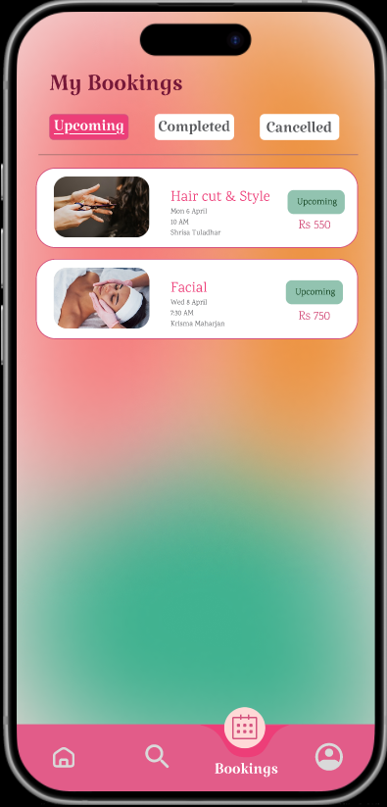
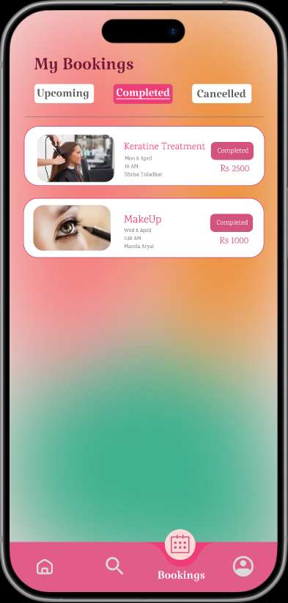
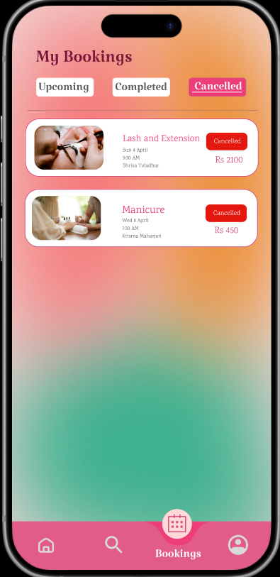
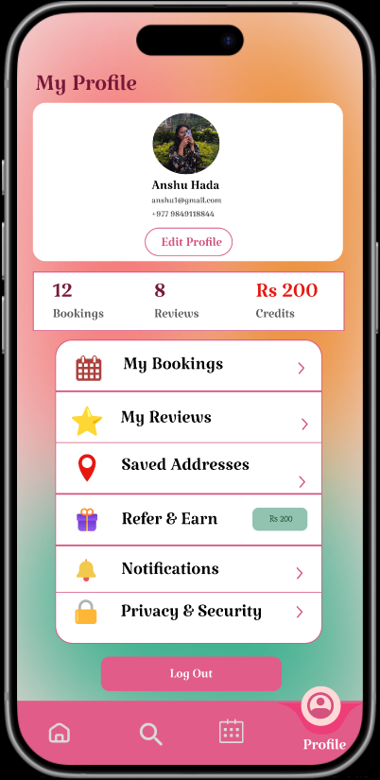
USER INTERFACE

Slide 16

KEY TAKEAWAYS
Deliver a seamless, intuitive user experience with a clean, beauty-forward design language.
Build trust through verified professional profiles, ratings, reviews, and background checks.
Provide a unified platform covering booking, payments, offers, and loyalty rewards.
Drive engagement with personalized recommendations and user-adaptive features.
Adopt iterative, user-driven design — continuously improve based on real feedback.
Build with scalability in mind: ready for city expansion, new service categories, and B2B growth.

Slide 17
THANK YOU !!!

